Slide 1
Using Continuous ETL
with Real-Time Queries
to Eliminate MySQL Bottlenecks
Damian.Black@sqlstream.com
Julian.Hyde@sqlstream.com
April 2009

Slide 2
Agenda
Background
Real-time Data Challenges
SQLstream’s Solution
Applications of SQLstream
Live Demo

Slide 3
SQLstream Company
Corporate:
Founded 2003, product launched 2008
Co-founded Eigenbase
Patented software technology
Experienced team
Presence in California, Colorado, UK
Privately funded

Slide 4
The Business Pain
Rising data volumes
Data Warehouse always out of date
  Poor Visibility into data still arriving from apps & users
  Painful Latency – data warehouse always out of date
Scaling for real-time performance proves costly
  Custom solutions, specialized hardware, bespoke integration
Scaling for massively distributed data is impossible

Slide 5
The SQLstream Solution
Fundamentally better way of processing real-time data
  Enhances the Data Warehouse performance and functionality
  Eliminates MySQL bottlenecks with Continuous ETL in declarative SQL
Simplifies Data Integration
  Continuous, real-time data integration yielding early visibility
  High level language, very productive and easy manage & maintain
Built on ISO and Industry standards
  Eigenbase and SQL:2003/SQL:2008
  Eclipse-based UI, standards-based drivers, meta data, SQL/MED
Query The Future™

Slide 6
SQLstream Eliminates Business Latency
Collect
Traditional data warehouse
SQLstream Innovation
Stage
Elimination of high latency processing stages via a pipelined approach
Classic approach delivers results the next day; SQLstream produces results continuously
Process
Query
Query
Deliver

Slide 7
SQLstream Enhances the Data Warehouse
Continuous ETL and keeping DW updated
Offloads the data warehouse from ELT, RT queries
Closes the loop: Data mining used for Real-time Detection
Continuous, RT business answers with near zero latency
Data Warehouse
data
data
SQLstream Preprocessor
data
data

Slide 8
Streaming SQL – an example
CREATE VIEW compliant_orders AS
SELECT STREAM *
FROM orders OVER sla
JOIN shipments
ON orders.id = shipments.orderid
WHERE city = 'New York'
WINDOW sla AS (RANGE INTERVAL '1' HOUR PRECEDING)
Produces a stream of orders from New York that shipped within a service level agreement of 1 hour

Slide 9
Streaming SQL
Built upon standard SQL:2003
  Familiar & declarative
Basics:
  Streams
  Tables
  Views
Streaming versions of relational operators:
  Projections and Filters (SELECT … FROM … WHERE)
  Windowed join (JOIN … OVER)
  Windowed aggregation
  Streaming aggregation (GROUP BY)
  Union

Slide 10
Mondrian
Open-source OLAP engine
Part of Pentaho Suite
Julian Hyde is lead developer
“ROLAP with caching”
Aggregate tables
Cache-control API
Viewers
JEE Application Server
Mondrian
cube
cube
cube
Cube
Schema
XML
JDBC
JDBC
JDBC
RDBMS
RDBMS

Slide 11
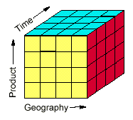
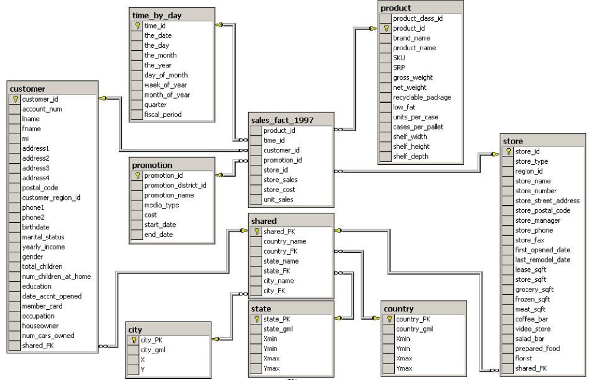
Mondrian schema
A dimensional model (logical)
  Cubes & virtual cubes
  Shared & private dimensions
  Measures
… mapped onto a star/snowflake schema (physical)
  Fact table
  Dimension tables
  Joined by foreign key relationships
  Aggregate tables

Slide 12
ETL Process for OLAP
OLAP
OLAP cache flushed after load
Conventional ETL
Operational
database
Data
warehouse
Aggregate tables populated from DW
SQLstream Inc. © 2009

Slide 13
Continuous ETL for Real-time OLAP
OLAP
OLAP cache flushed proactively
SQLstream Continuous ETL
Operational
database
Data
warehouse
Aggregate tables populated incrementally
SQLstream Inc. © 2009

Slide 14

Real-time charts and alerts
Charts generated from SQLstream
Real-time alerts
OLAP
Operational
database
Data
warehouse
SQLstream Continuous ETL
SQLstream Inc. © 2009
Notes:
14

Slide 15
Demo
  Moving charts
  Mondrian
  SQLstream Studio

Slide 16
Where Real-time DW / OLAP really helps
Advertising
  Measuring results in real-time to manage budgets, ROI
  Finding costly errors ASAP
  Promoting & demoting campaigns
  Matching punters to products: win impulse buyers, get ahead of rivals
Social Networking
  Above plus: adapting content to real-time activity, interests
Commerce
  Above plus: pricing that reacts to inventory, competition
  Creating bundles dynamically
  Smart loyalty programs

Slide 17
The SQLstream Advantage: Do More with Less
Changing the Economics of ETL and Data Integration
  Leverages SQL skill sets in new ways
    Fewer and cheaper consultants for real-time integration
    Much lower development and maintenance costs
  Offloads existing Data Warehouses
    Reduces and defer infrastructure upgrades
    Enhances DW performance
  Make better business decisions faster
    Data Warehouses kept always up-to-date
    Continuous & real-time alerts and analytics

Slide 18
Questions?

Slide 19
Thank you for attending!
www.sqlstream.com

